Slide 1
2. Rural areas
2018-3-HR01-KA205-060151
Agrotourism

Slide 2
characteristics
Open swath of land that has few homes or other buildings, and not very many people.
A rural area’s population density is very low.
Agriculture is the primary industry in most rural areas.
Most people live or work on farms or ranches. Hamlets, villages, towns, and other small settlements are in or surrounded by rural areas.
Throughout the world, more people live in rural areas than in urban areas. This has been changing rapidly, however. Urbanization is happening all over the world. In Asia, for example, the United Nations estimates that the urban population will increase by almost 2 billion by 2050.

Slide 3
Countryside
Wildlife is more frequently found in rural areas than in cities because of the absence of people and buildings.
Rural areas are often called the country because residents can see and interact with the countrys native wildlife.

Slide 4
Transforming the Rural Areas
Rural areas change over time. These changes are caused by:
economic factors - tourism income, farming profitability, primary sector jobs
environmental factors - land use, pollution, conservation
social factors - population change and migration, leisure time, retirement population
Property, Markets, Cooperatives, and Technological Change

Slide 5
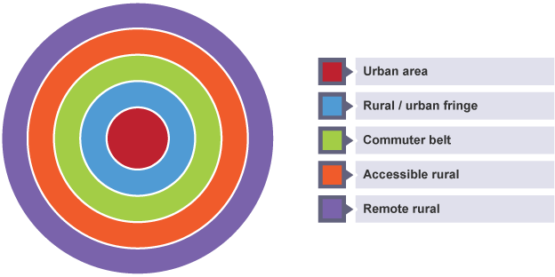
Types of rural areas Classification

Slide 6
Pressures in rural areas
Decline in primary employment
Commuting areas
Retirement homes
Second homes
Land use
Infrastructure

