Slide 1

5. Agritouristic Destinations
2018-3-HR01-KA205-060151
Agrotourism

Slide 2
Agritourism is one of the fastest growing sectors in the eco-tourism industry.
  There is nothing new about this form of travel, which involves staying on a farm or other agriculture-oriented property and perhaps even sampling the day-to-day lifestyle of the people who tend the crops or livestock there
  Examples and case studies

Slide 3
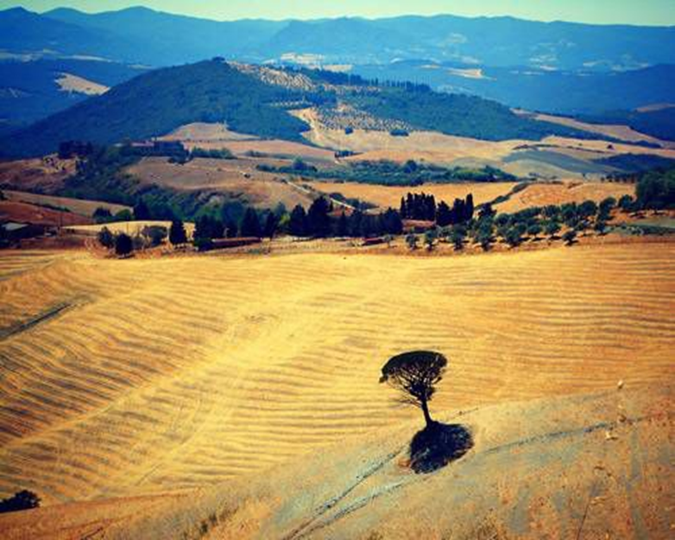
Tuscany

Slide 4
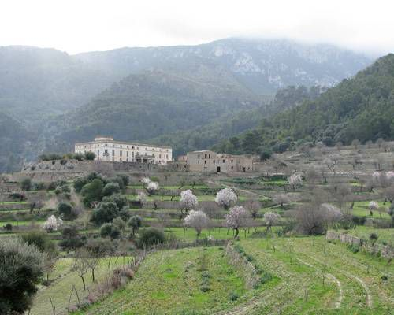
Mallorca

Slide 5
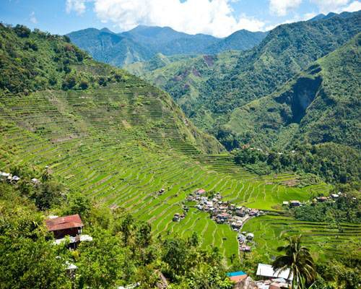
Philippines

Slide 6
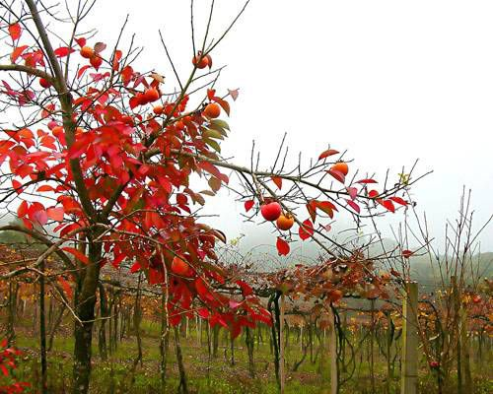
Brazil

