Slide 1

7. Economics and business analysis of agro-tourism economy
2018-3-HR01-KA205-060151
Agrotourism

Slide 2
Developing and Planning
role of tourism for local economic development (LED) is of critical importance
  vehicle for promoting local employment and development opportunities
  local planning initiatives which are designed to build up localities as centers for consumption rather than for production purposes
rural restructuring in ‘intermediate tourism spaces’
  catalyst for revitalizing troubled rural agrarian economies
  benefits:
    additional revenues can help: sustain businesses, retain rural lifestyles, keep farmlands
    environmental amenities,
    recreational opportunities,
    landscape management,
    biodiversity and cultural preservation

Slide 3
Factors determining price
Product cost
The Utility and Demand
Extent of Competition in the Market
Government and Legal Regulations
Pricing Objectives
Marketing Methods Used

Slide 4
pricing objectives of any business
1.Profit Maximisation
2.Obtaining Market Share Leadership
3.Surviving in a Competitive Market
4.Attaining Product Quality Leadership

Slide 5
Site Management
Best Management Practices for an agritourism business include:
providing an authentic farm or ranch experience,
providing an educational experience,
providing excellent customer service,
providing adequate public facilities,
maintaining a safe and accessible environment,
creating good community relations, and
planning for your financial future

Slide 6
Assessing potential
Once you have a sense of visitor interests, market trends and the range of possible activities, the next step is to assess how agritourism fits your skills and interests, your property, and the marketplace
SELF-ASSESSMENTS
Is Agritourism a Fit for You and Your Family?
Is Your Property Suitable for Agritourism?
Do You Have Time?
Is There a Customer Base for Your Idea?
What Connections Are Important to Your Success?

Slide 7
Myth | Reality
Agritourism takes a lot of financial investment. | The number of assets you already have may surprise you.
Agritourism means you never get a break. | There are many activities from which to choose. You are your own boss and can choose when you want to operate the agritourism business.
Agritourism requires many big changes. | You can decide what works best for your location, so the need for changes will depend on your vision of the new business.
Agritourism requires a lot of experience to be successful. | The basics of agritourism success take good planning and management. This requires diligence and not necessarily a lot of experience.
Starting an agritourism business requires the hiring of new employees. | You can decide how large your operation is going to be. Many activities require only you.
Agritourism means that a large number of people will be on my land. | You can control your comfort level with visitors. You can be active in agritourism even with just one customer at a time.
Agritourists are annoying and will be a nuisance. | You can match agritourism activities to things that interest you. Good matching will mean that you are more likely to attract people to whom you can relate.

Slide 8
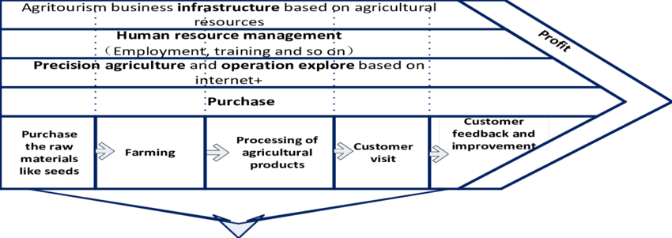
Potential versus value
How do you define value? Can you measure it? What are your products and services actually worth to customers?
Customer value models - data-driven representations of the worth, in monetary terms, of what the supplier is doing or could do for its customers

Slide 9
Consumers
Who are agrotourism consumers?
Demografic:
  an extended age range
  usually have a high economic and educational level
  seek relaxation (cut off from everyday life in the city)
Activities:
  on-farm activities based on educational and nature experiences are most popular, followed by food and culinary activities
Promotion channels:
  past experiences and recommendations, personal web search

