Slide 1

8. Agritourism marketing
2018-3-HR01-KA205-060151
Agrotourism

Slide 2
Agritourism marketing
What is Marketing Strategy?
Create a Marketing Plan
The Four P’s
Digital and Social Media Marketing
Assessment “Develop and present marketing strategy for your start-up idea”

Slide 3
What Is a Marketing Strategy?
A marketing strategy refers to a business's overall game plan for reaching prospective consumers and turning them into customers of the products or services the business provides.
A marketing strategy contains the company’s value proposition, key brand messaging, data on target customer demographics, and other high-level elements

Slide 4
Marketing Strategies vs. Marketing Plans
The marketing strategy informs the marketing plan, which is a document that details the specific types of marketing activities a company conducts and contains timetables for rolling out various marketing initiatives.
Marketing strategies should ideally have longer lifespans than individual marketing plans because they contain value propositions and other key elements of a company’s brand, which generally hold consistent over the long haul.
In other words, marketing strategies cover big-picture messaging, while marketing plans delineate the logistical details of specific campaigns.

Slide 5
The Creation of Marketing Strategy
A carefully-cultivated marketing strategy should be fundamentally rooted in a company’s value proposition, which summarizes the competitive advantage a company holds over rival businesses
Whether it's a print ad design, mass customization, or a social media campaign, a marketing asset can be judged based on how effectively it communicates a company's core value proposition.
Market research can be helpful in charting the efficacy of a given campaign and can help identify untapped audiences, in order to achieve bottom-line goals and increase sales

Slide 6
Create a Marketing Plan (i)
EXECUTIVE SUMMARY
ENVIRONMENTAL ANALYSIS
  The Marketing Environment
  Target Market(s)
  Current Marketing Objectives and Performance
SWOT ANALYSIS
  Strengths
  Weaknesses
  Opportunities
  Threats
  Matching Strengths to Opportunities/ Converting Weaknesses and Threats

Slide 7
Create a Marketing Plan (ii)
.
.
MARKETING OBJECTIVES
MARKETING STRATEGIES
  Target Market(s)
  Marketing Mix
MARKETING IMPLEMENTATION
  Marketing Organization
  Activities, Responsibility, and Timetables for Completion

Slide 8
Create a Marketing Plan (iiI)
.
.
.
.
.
EVALUATION AND CONTROL
  Performance Standards and Financial Controls
  Monitoring Procedures

Slide 9
The Four P’s
products
price
distribution
promotion

Slide 10
Digital and Social Media Marketing
Digital marketing is about the implementation of a variety of customized digital media marketing channels to achieve any of the following objectives:
To grow your products or services sales and profits
Create your brand awareness and build a strong relationship with your target audience
Create and add value
Promote your products or services or brand
And many more!
Social media marketing is only one aspect of digital marketing.
It implies the use of social media channels such as Facebook, Twitter, Instagram, YouTube, Goggle+, Snapchat, etc. to marketing your products, services, or brand.
Typically, it involves engagement with your target audience, followers, seeking industry influencers, posting fresh and unique content, arranging contests and adopting a variety of other means to grab the attention of the audience present on different social media channels

Slide 11
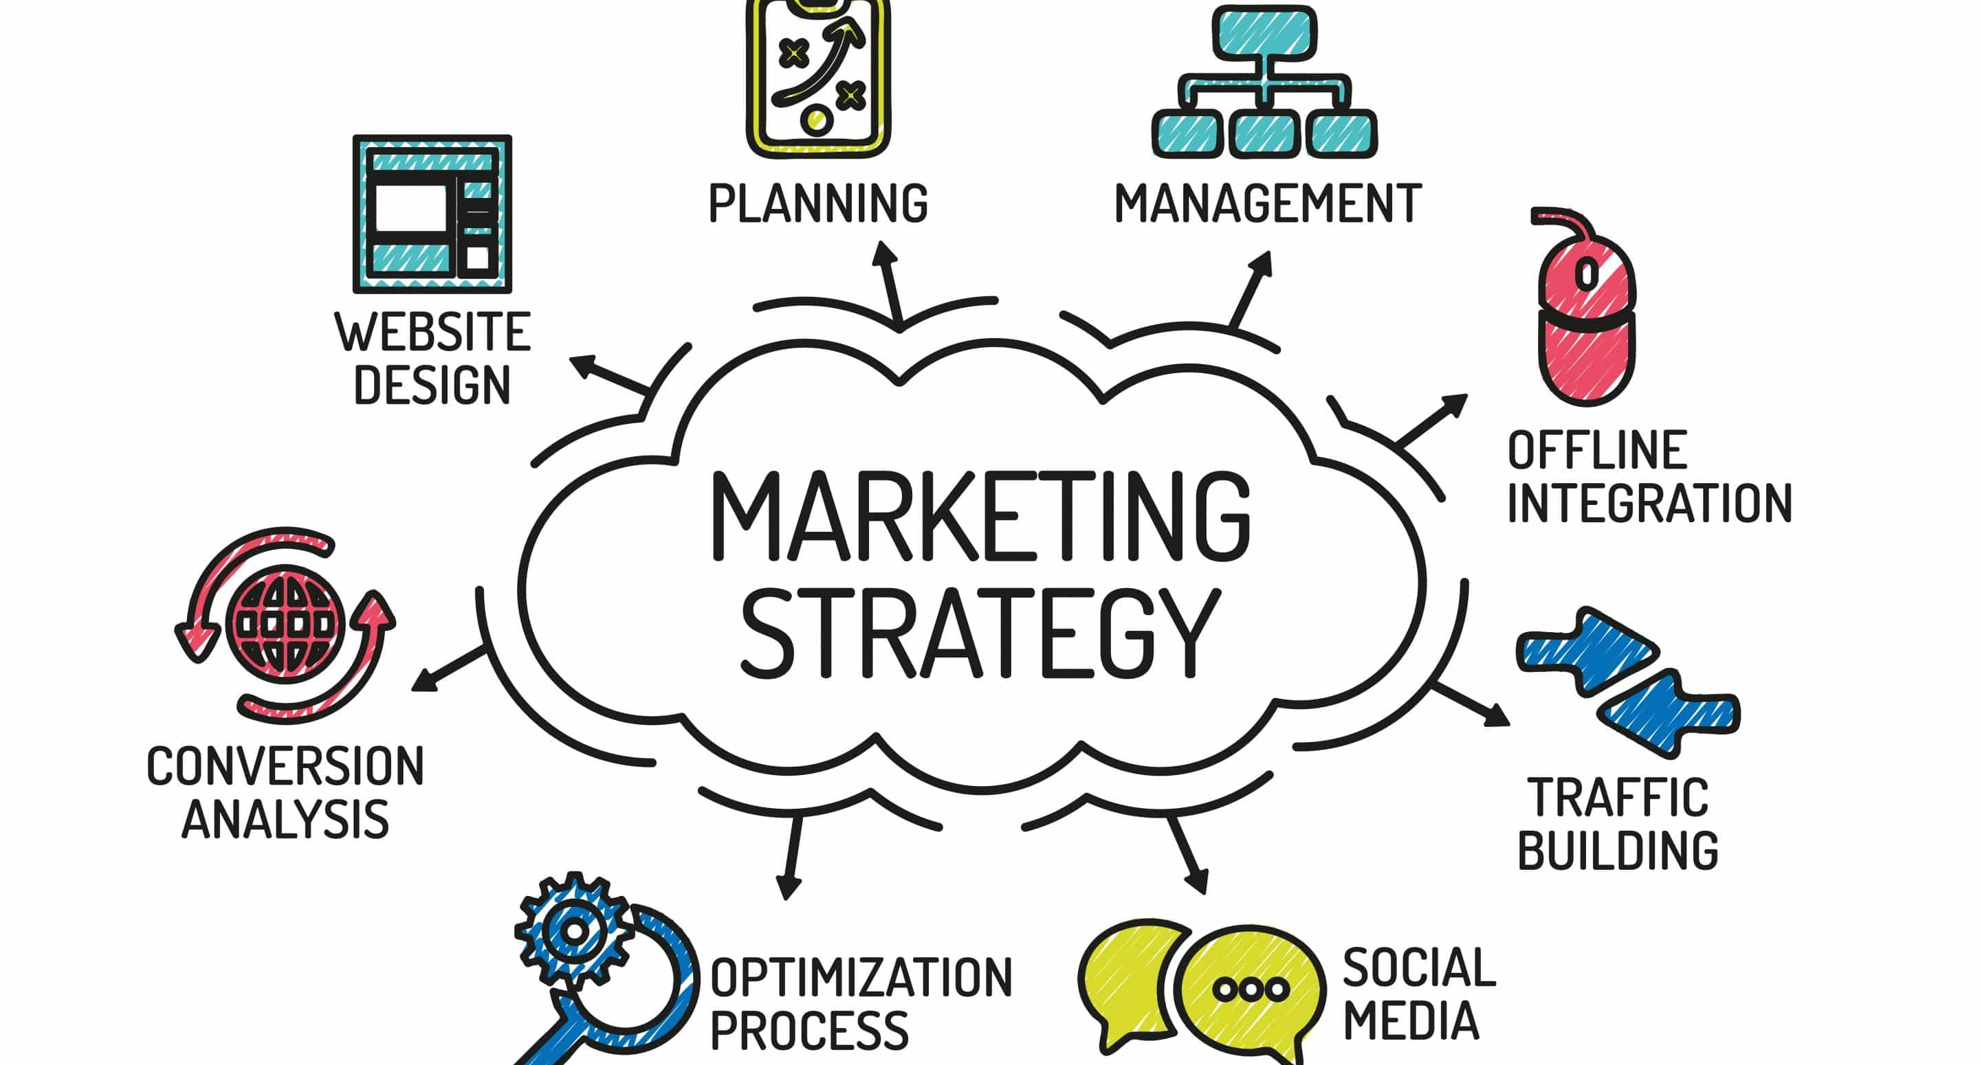
Assessment
“Develop and present marketing strategy for your start-up idea”

