Slide 1
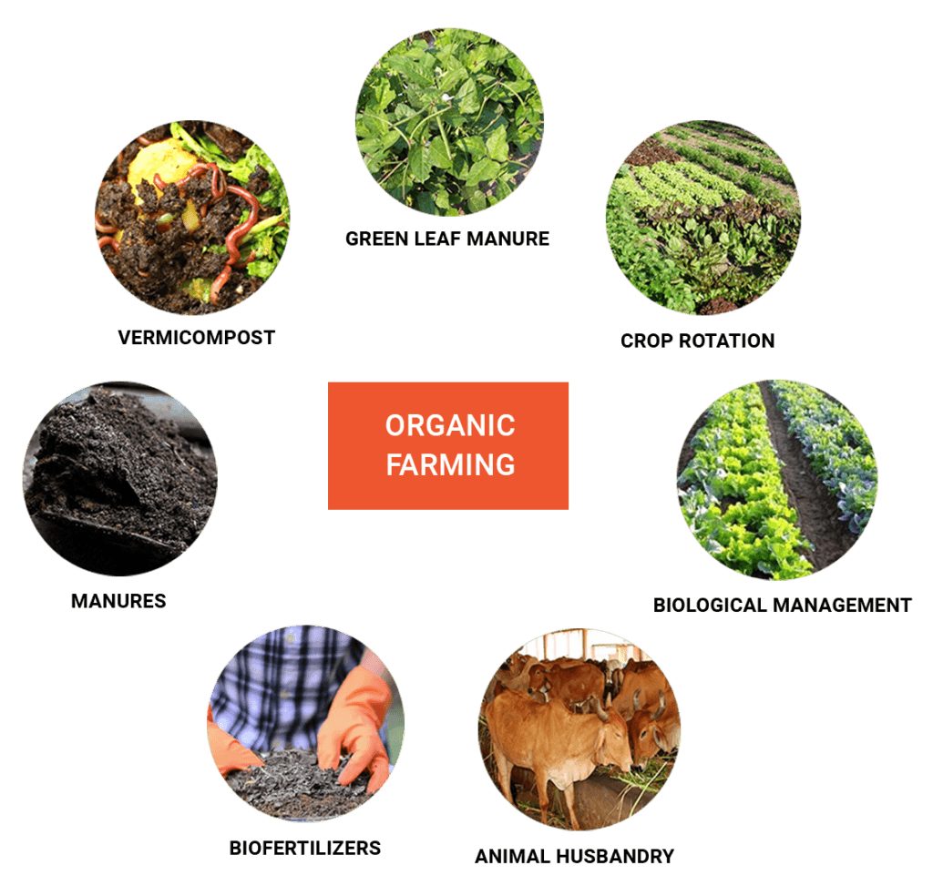
Training for Organic Agriculture
2018-3-HR01-KA205-060151
Organic Agriculture

Slide 2
training for organic agriculture
Organic Agriculture is an overall system to manage a farm and produce food, while ensuring:
The health of soils, ecosystems and people.
High level of biodiversity.
The preservation of natural resources.
Best environmental practices, and
High animal welfare standards.

Slide 3
Examples of Production Methods
These main principles of Organic Agriculture have to be translated (by the farmer) into concrete production methods, such as:
Multi-annual crop rotations (for an efficient use of on-site resources).
The use of livestock manure as a fertilizer and growing only what the farm can naturally yield.

Slide 4
Examples of Production Methods
Encourage natural resistance to pests and diseases, both in crops and livestock.
Encourage to have suitable habitats for the benefit of the animals to help control pests in a natural way.
Provide access to quality feed and free range pasture to maintain the health of the animals.

