Slide 1
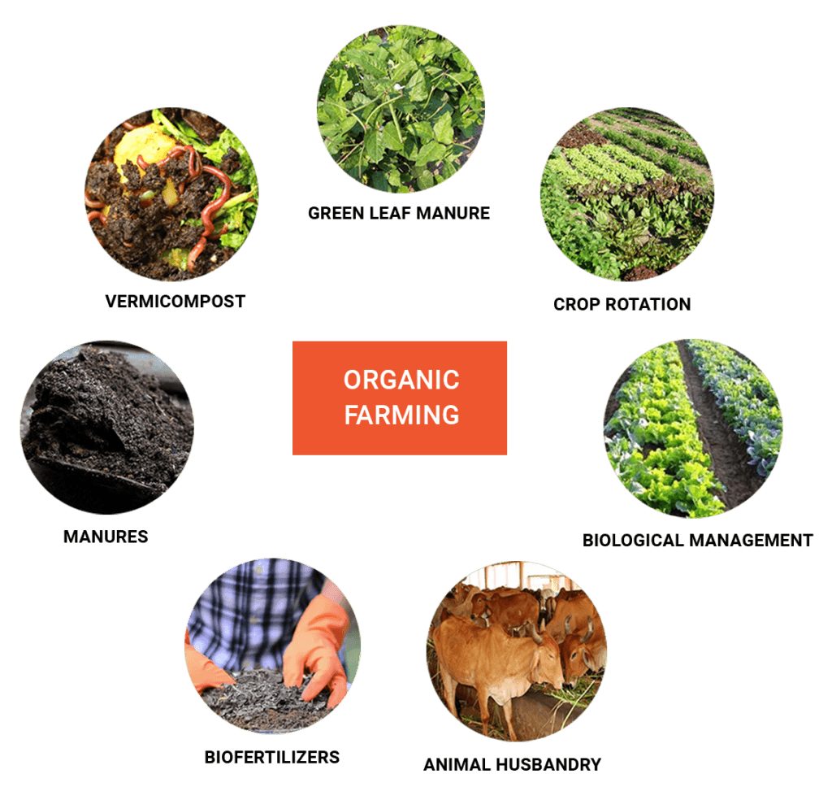
Certification Process
2018-3-HR01-KA205-060151
Organic Agriculture

Slide 2
get Certified
All food producers, processors or traders who wish to market their food as Organic need to be registered with a control agency or body.
Therefore, in order to become an organic farmer, one should contact an agency or body of Organic Farming in the respective Member State.

Slide 3
get Certified
Each EU member appoints “control bodies or authorities” in order to:
Provide detailed information for the particular segment of Organic Farming
Run controls on each organic farm, and
Investigate whether the production is in compliance with organic rules.

Slide 4
Certification process
All operators are checked by a control agency or body at least once a year to make sure that the rules are respected.
If the rules are respected, the products may bear the Organic Logo.
The main objective of the Organic Logo is to make Organic products easier to be identified by consumers.
“If you wish to become an organic farmer, you must be certified through a control body”.

